Slide 1
Reverse Engineering with Ghidra
Cyber Club Slides

Slide 2
Downloads Needed to Follow Along
The downloads can be found here:
https://john-gunst.github.io/CyberClubFileHosting.html
Ghidra
bbbbloat example binary

Slide 3
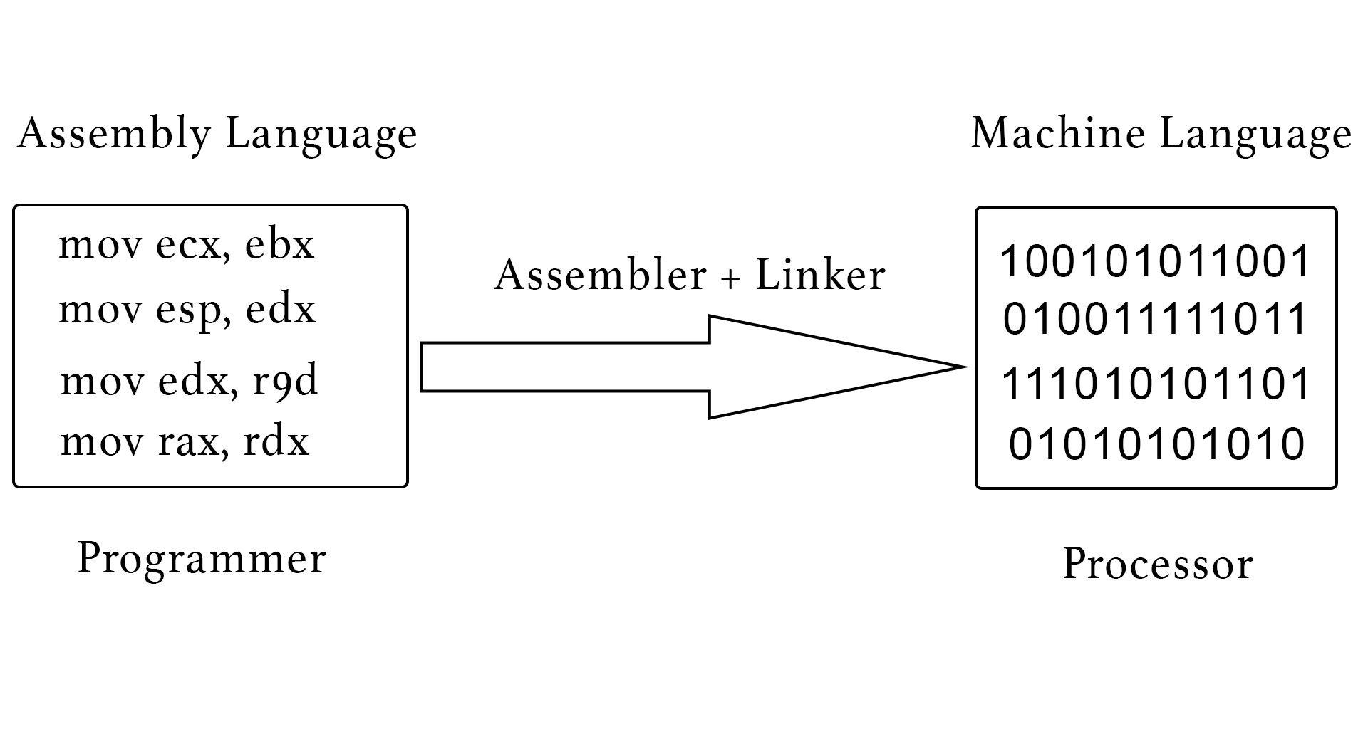
What is Reverse Engineering in Cyber?
The process of analyzing programs
Important for analyzing malware
Usually done by compiling them into assembly
Assembly is difficult to read
Debuggers provide helpful tool for analysis
One of the best tools is Ghidra

Slide 4

What is Ghidra
Open source
Developed by the NSA
Made to make reverse engineering easier
Existed as early as 1999
Released in 2017

Slide 5
How to use Ghidra

Slide 6
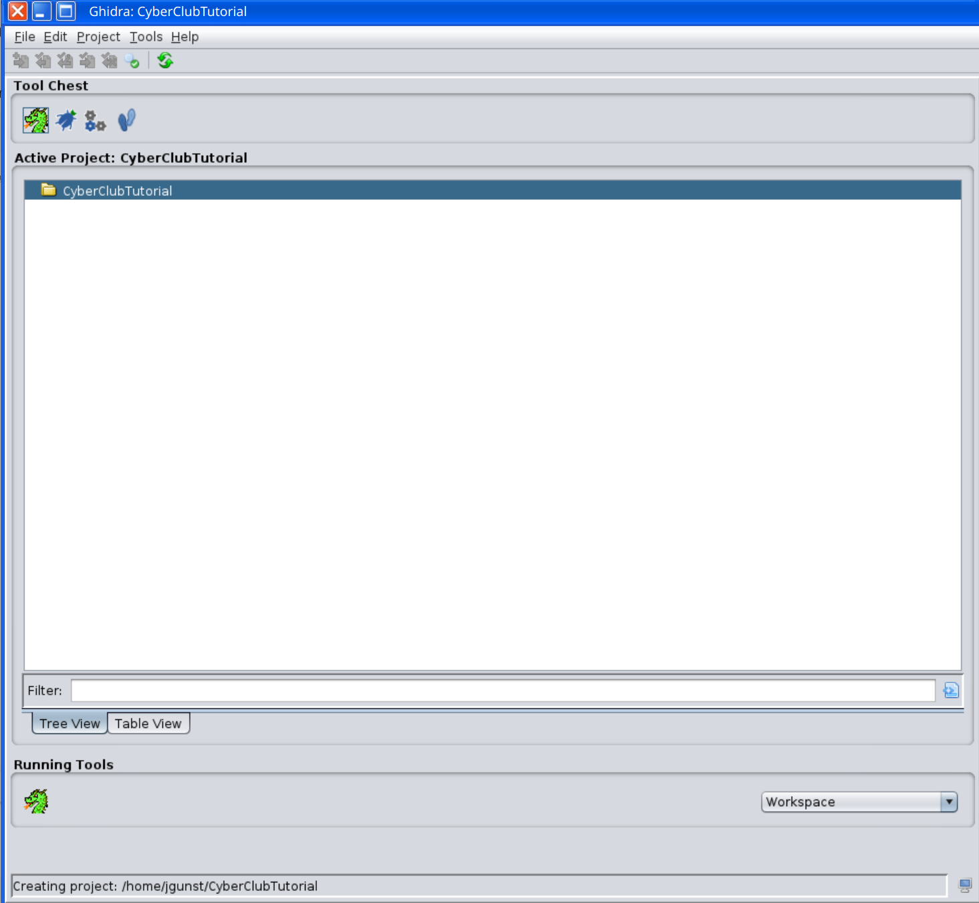
Create a New Project
1. Open Ghidra
2. Click File
3. Click New Project
4. Name Project
5. When finished click the dragon

Slide 7
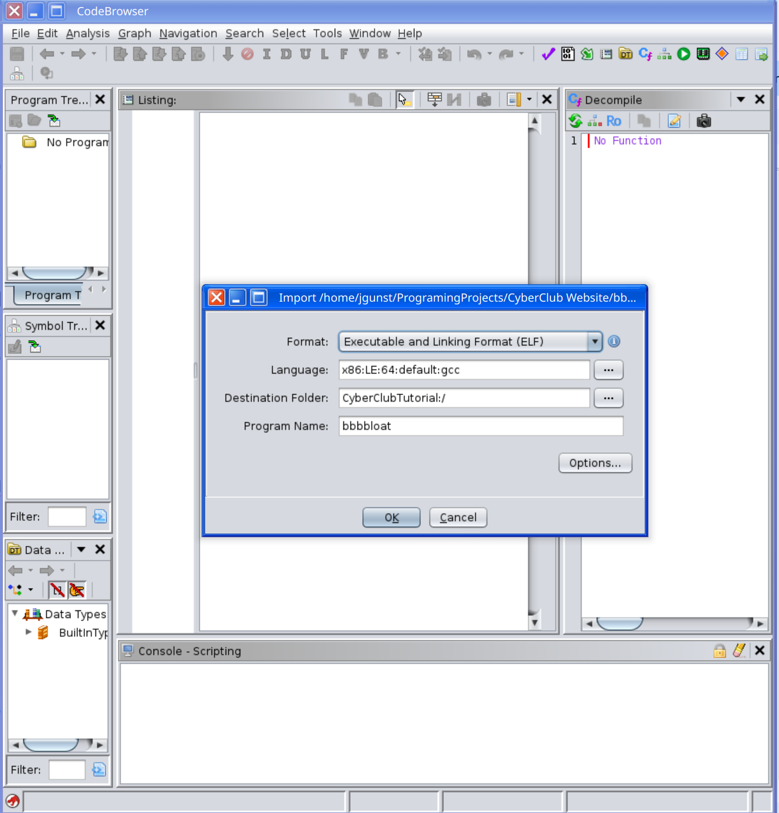
Import Your Binary
You are now in the Code Browser!
1. Click File
2.Click Import
3.Navigate the file system for bbbbloat
4. Click bbbbloat
5. Click ok for the subsequent prompt
6. Click analyze

Slide 8
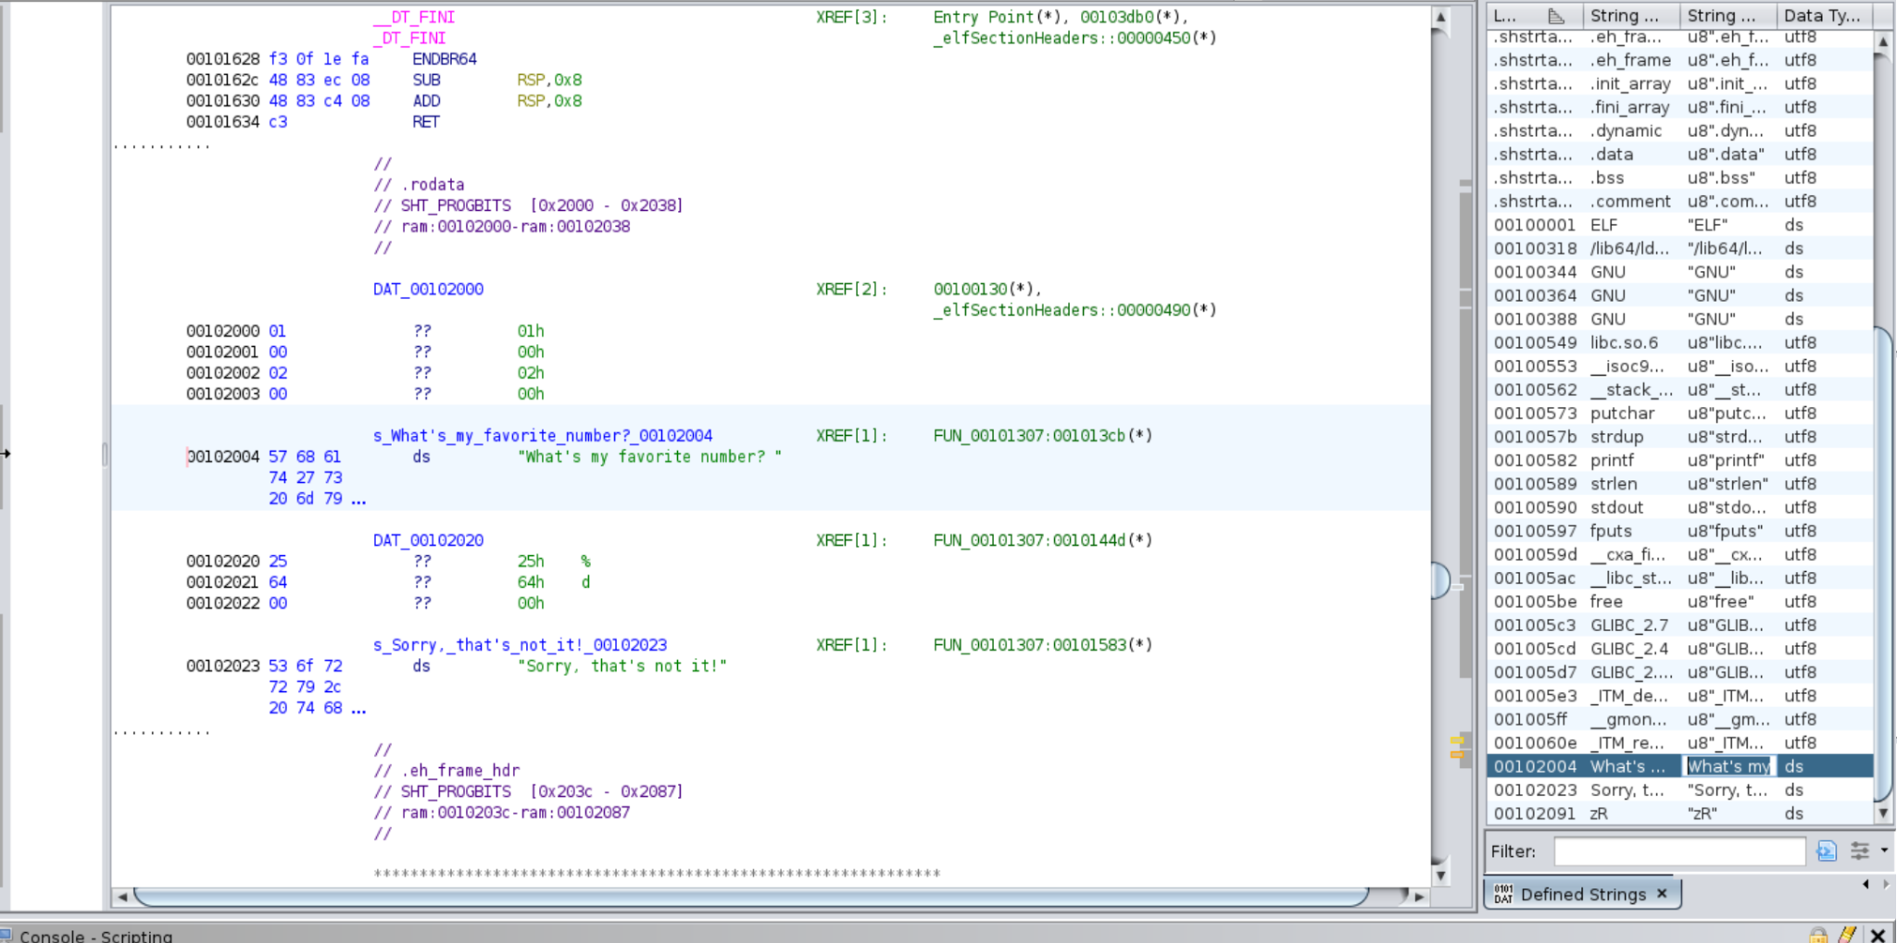
Searching for Strings
*Strings will tell you where certain strings are printed at
1. Click Window
2. Click Defined Strings
3. Scroll the window to find the string, "What's my favorite number?"
4. Click the string to go to the line of code it's referenced in
5. Notice the XREF, this shows the memory address of where it is called within a function

Slide 9
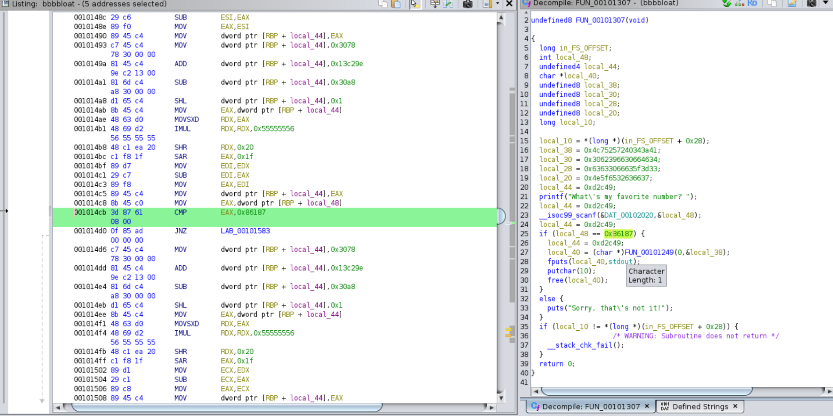
Looking at the Functionality
1. Click XREF
2. Click window
3. Click Decompile
4. Notice the if statement checking to see if the number is 0x86187
5. Right click to see its value in decimal

Slide 10
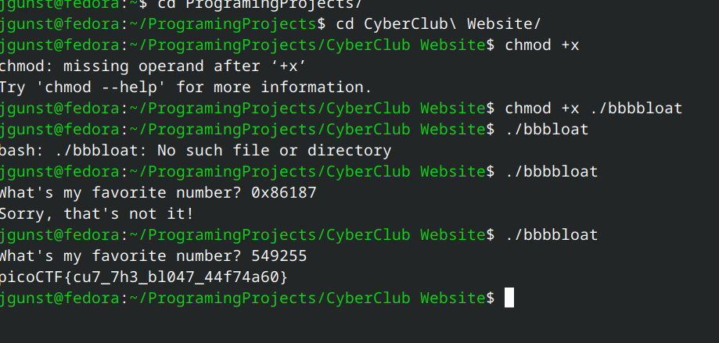
Getting the Flag!
1. Run the program
2. Put in the decimal value when prompted
3. Receive flag

